Slide 1
Introduction to Deep Learning with TF(CNN)
Dr. Suraiya Zabeen

Slide 2





















Introduction about me
PhD
in Aerospace Materials 2011
BSc in Materials Engineering
Notes:
Good evening everyone, Fellow toastmaster,
I am someone who is passionate about learning and teaching. I went ahead with learning how to learn.
Let us delve deeper into our brain and see how our brain works.

Slide 3
L
Intro..
Learning outcome
What is a Neural Network?
Introduction Convolutional Neural Network
Building a simple CNN model using Tensorflow Keras
Input data using tensorflow dataset (tfds)
Specify input, hidden, and output layers in the DNN architecture
Review and visualize the final DNN shape
Train the model locally and visualize the loss curves

Slide 4

Learning outcome

Slide 5
Intro..
1. Your background 2. What industry are you interested in? 3. Your expectation from this class

Slide 6
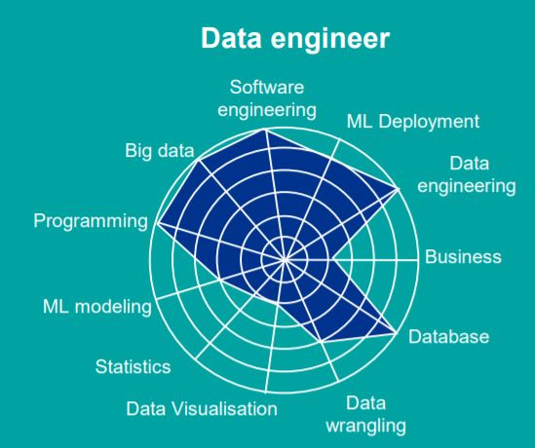
Skills required for different roles in DS ML industry

Slide 7
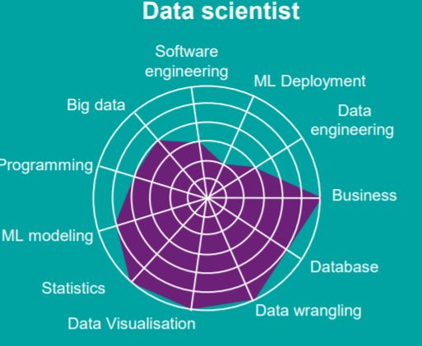
Skills required for different roles in DS ML industry

Slide 8
What is Machine Learning?
Machine Learning
AI
Deep Learning
Algorithms that parse data , learn from it , and then apply what they’ve learned to make informed decisions. They use human extracted features from data and improve with experience
Algorithms that mimic the intelligence of humans , able to resolve problems in ways we consider “smart”. From the simplest to most complex algorithms.
Neural Network algorithms that automatically learn the important features in the data. Able to adapt by repetitive training to uncover hidden patterns and insights
Using Data to Predict Answers

Slide 9


Machine Learning Applications
Health Care
Marketing
Banking and Financial Market and services
Diagnosis and disease identification
Medical imaging diagnostics
Digital Consultation
New drug discovery
Manufacturing
Retail and E- commerce
Predictive maintenance - equipment failure
Implementation of safety rules
Quality Control
Controlling energy Consumption
Inventory management
Notes:
https://www.soleblogger.com/best-machine-learning-applications-for-web-designing-building/

Slide 10
Recap: Linear Regression Model
bias
Prediction
weights
Feature

Slide 11
What factors determine the value of a vehicle?
Fuel consumption
Engine size
Car age
Make
Model

Slide 12
A linear model can be represented as nodes and edges
Output
Input

Slide 13
A linear model can be represented as nodes and edges
Input
Output
Hidden layer 1

Slide 14
Adding a non-linear Transformation layer
it stops the layers from collapsing back into just a linear model.
helps create interesting transformations to our data's feature space
it allows for deep composition of functions.
Input
Hidden layer-1
Activation Function
Hidden layer-2
Output
Notes:
because it stops the layers from collapsing back into just a linear model. Not only do non-linear activation functions help create interesting transformations to our data's feature space, but it allows for deep composition of functions.

Slide 15
What is activation function?
An activation function in a neural network defines how the weighted sum of the input is transformed into an output from a node or nodes in a layer of the network.

Slide 16
Types of Activation Function
Sigmoid
TanH
Rectified Linear Unit
Leaky ReLU

Slide 17
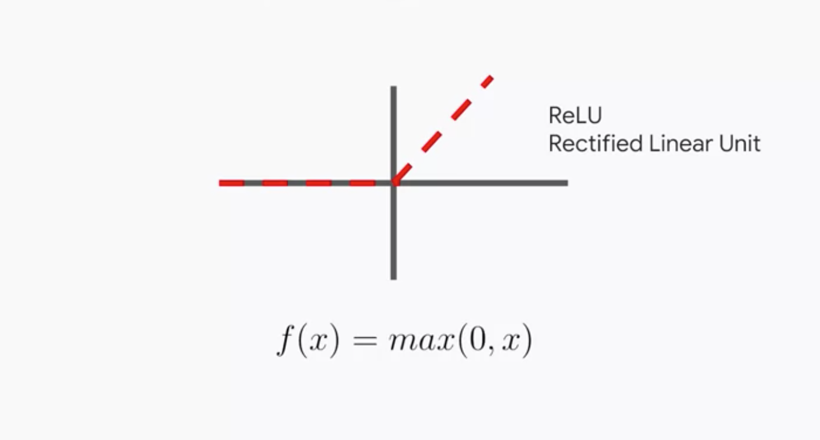
Rectified Linear Unit
F(x)=x if x≥0 and
0 if x<0

Slide 18
Convolutional Neural Network
? A Convolutional Neural Network is a class of artificial neural network that uses convolutional layers to filter inputs for useful information.
1. Input layer
2. Single or multiple Convolutional layer
3. Pooling Layer
4. Flatten Layer
5. Dense Layer
Notes:
Flattening is converting the data into a 1-dimensional array for inputting it to the next layer.

Slide 19
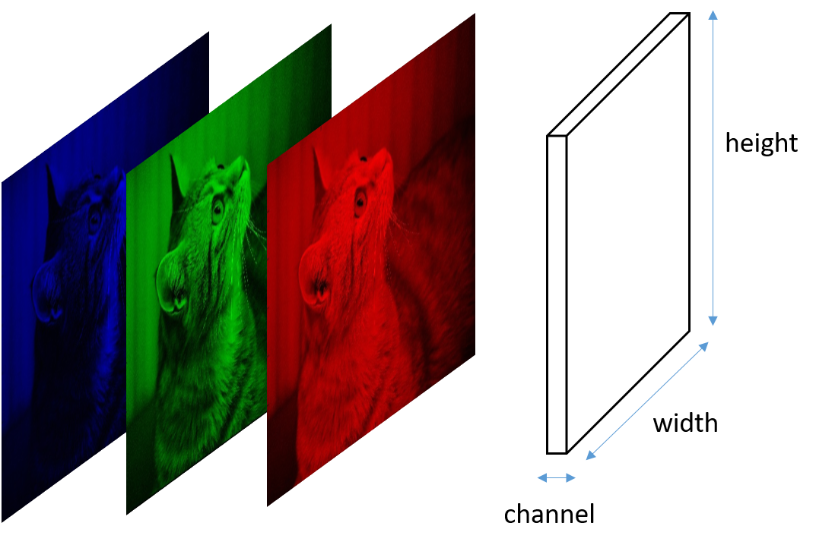
Input Layer
Blue
Green
Red
Input image
Input shape = (height , width, no of channels)

Slide 20
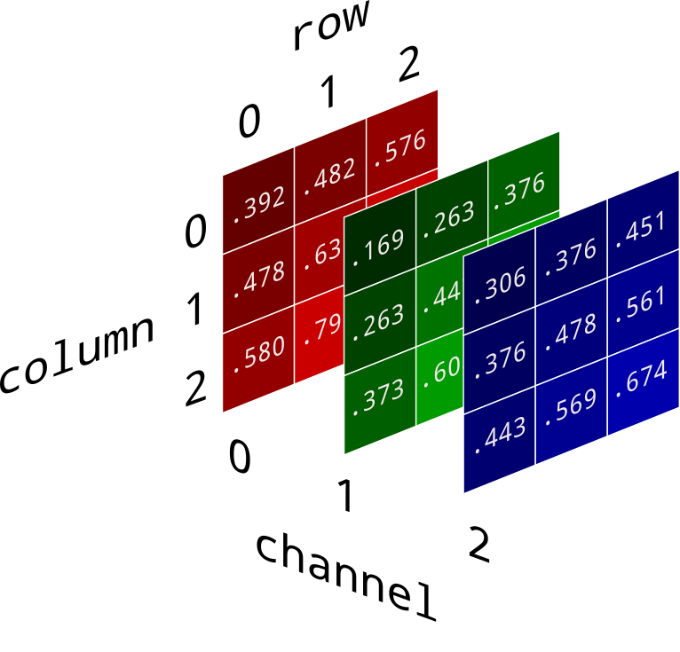
Input Layer

Slide 21
What is Convolution?
The convolution operation involves combining input data (feature map) with a convolution kernel (filter) to form a transformed feature map. The filters in the convolutional layers (conv layers) are modified based on learned parameters to extract the most useful information for a specific task.

Slide 22
What is Convolution?
The convolution operation involves combining input data (feature map) with a convolution kernel (filter) to form a transformed feature map. The filters in the convolutional layers (conv layers) are modified based on learned parameters to extract the most useful information for a specific task.
Convolution Parameters
1. Kernel Size
3. Stride
4. Padding

Slide 23
Convolution Parameters?
Kernel Size
Kernel size
Dimensionality of kernel. In case above it was 3x3 kernel (pretty popular choice).
It can be specified as a tuple, e.g. (3, 3)
It can be irregular (e.g. (3, 2)), though it is rarely a case (if it is, it almost always is (N, 1) or (1, N))
The larger the kernel, the larger is it's receptive field but more computations have to be performed

Slide 24
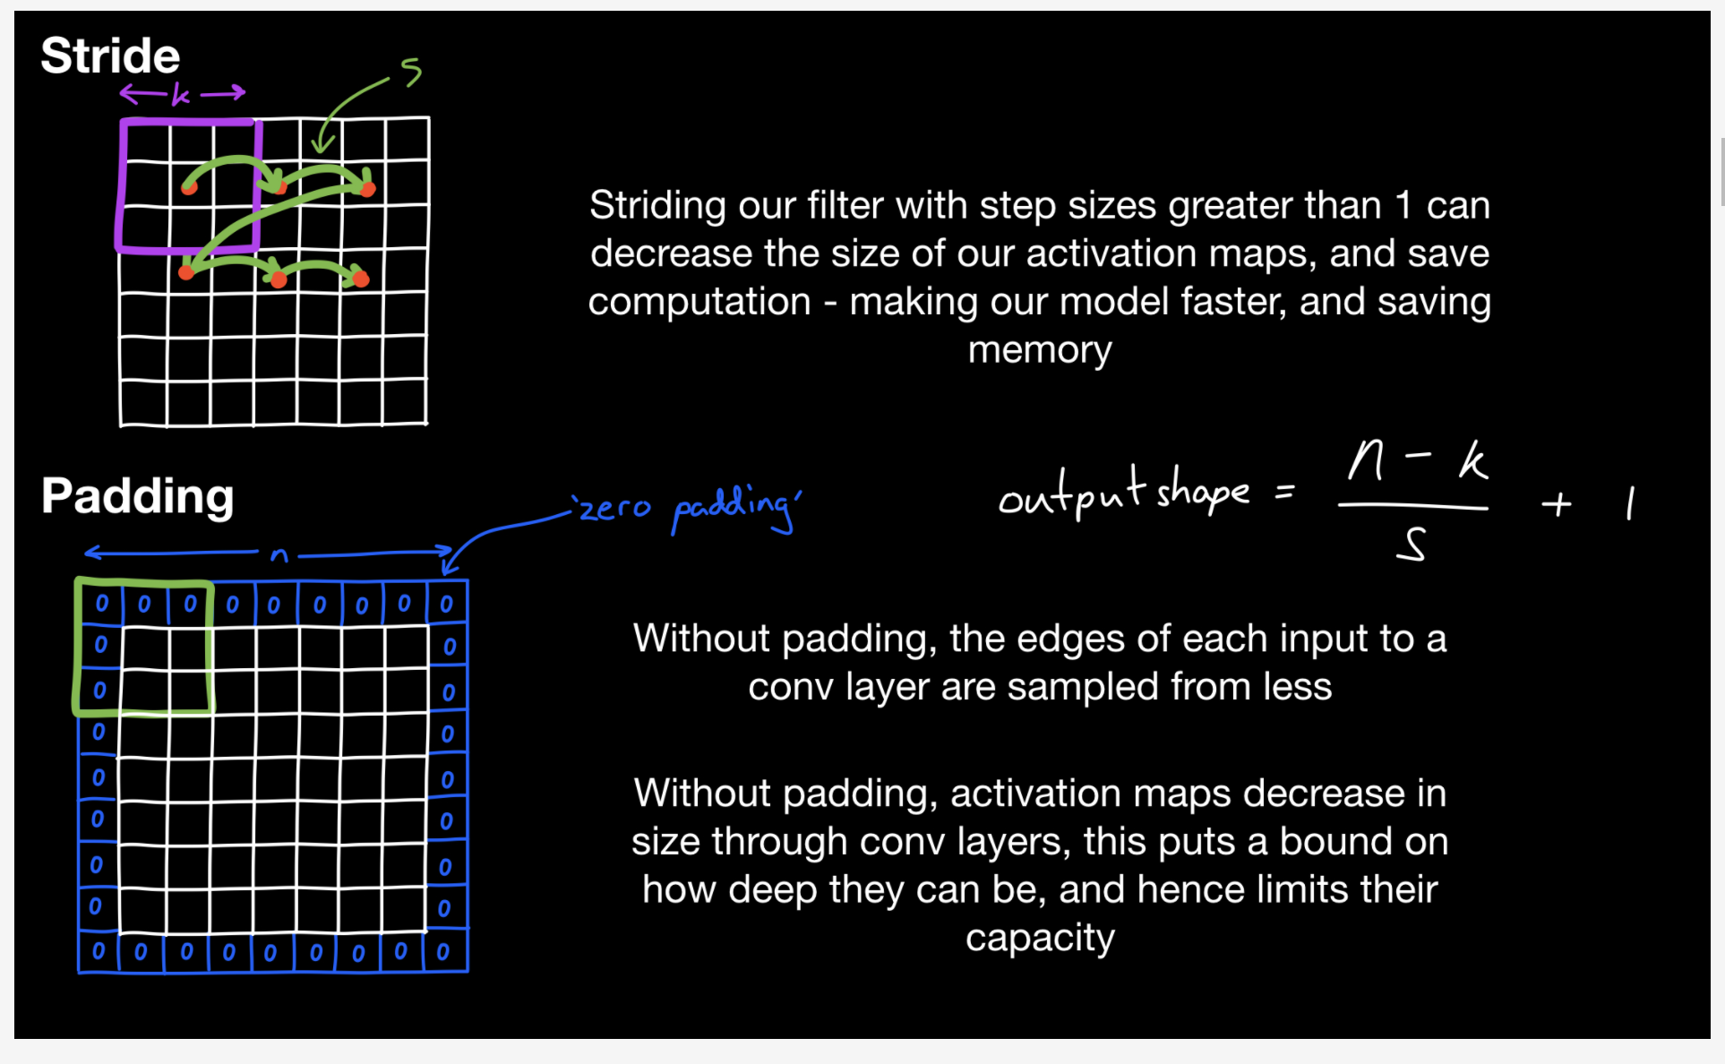
Stride and padding

Slide 25
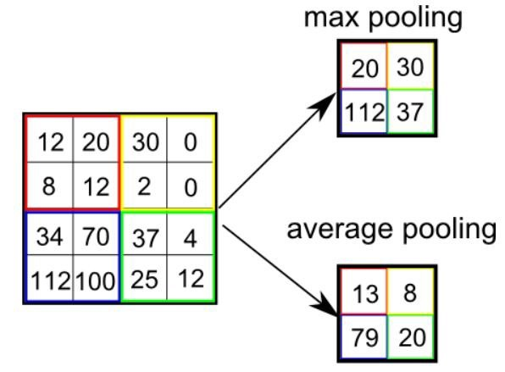
Pooling layer
Pooling allows us to control when we want to shrink image's width and height
As the network gets deeper we increase number of channels in order to learn more abstract representations, hence computational cost increases quickly
Pooling allows us to control computational cost of operations
Pooling chooses the most important features from the image

Slide 26
Flatten layer

Slide 27
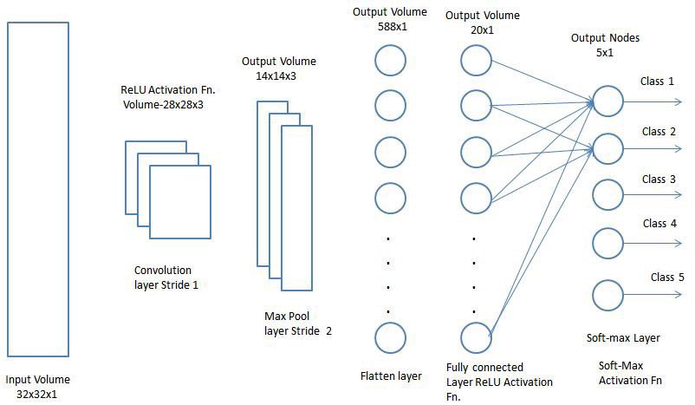
Dense Layer or Fully Connected Layer

Slide 28
SoftMax layer

Slide 29
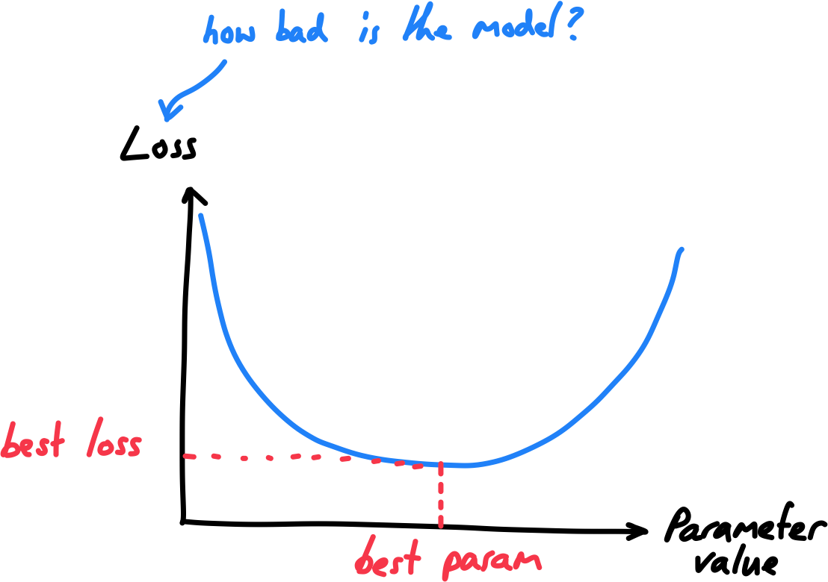
Optimization - Strategy to improve performance
Data
Model
Evaluation - model performance
Optimization

Slide 30
Useful Pandas Commands
Import pandas as pd
df = pd.read_csv (for reading a file)
df.to_csv(r'Path where you want to store the exported CSV file\File Name.csv’) for Saving a file
df.head() View the first few lines of file
df.describe Find the count, mean, min, max, STD
df.corr() correlation
df.columns()
df.shape
Df.dtypes

Slide 31
Build the Model
The steps to building and using a model are:
Define: What type of model will it be? A decision tree? A regression model , a classification.
Fit: Capture patterns from provided data. This is the heart of modeling.
Predict: Just what it sounds like
Evaluate: Determine how accurate the model's predictions are.
Notes:
You will use the scikit-learn library to create your models. When coding, this library is written as sklearn, as you will see in the sample code. Scikit-learn is easily the most popular library for modeling the types of data typically stored in DataFrames.

Slide 32
Scikit learn
scikit-learn (abbreviated sklearn) is a high-level machine learning library containing:
machine learning algorithms
example datasets
data pre-processing & pipelines

Slide 33
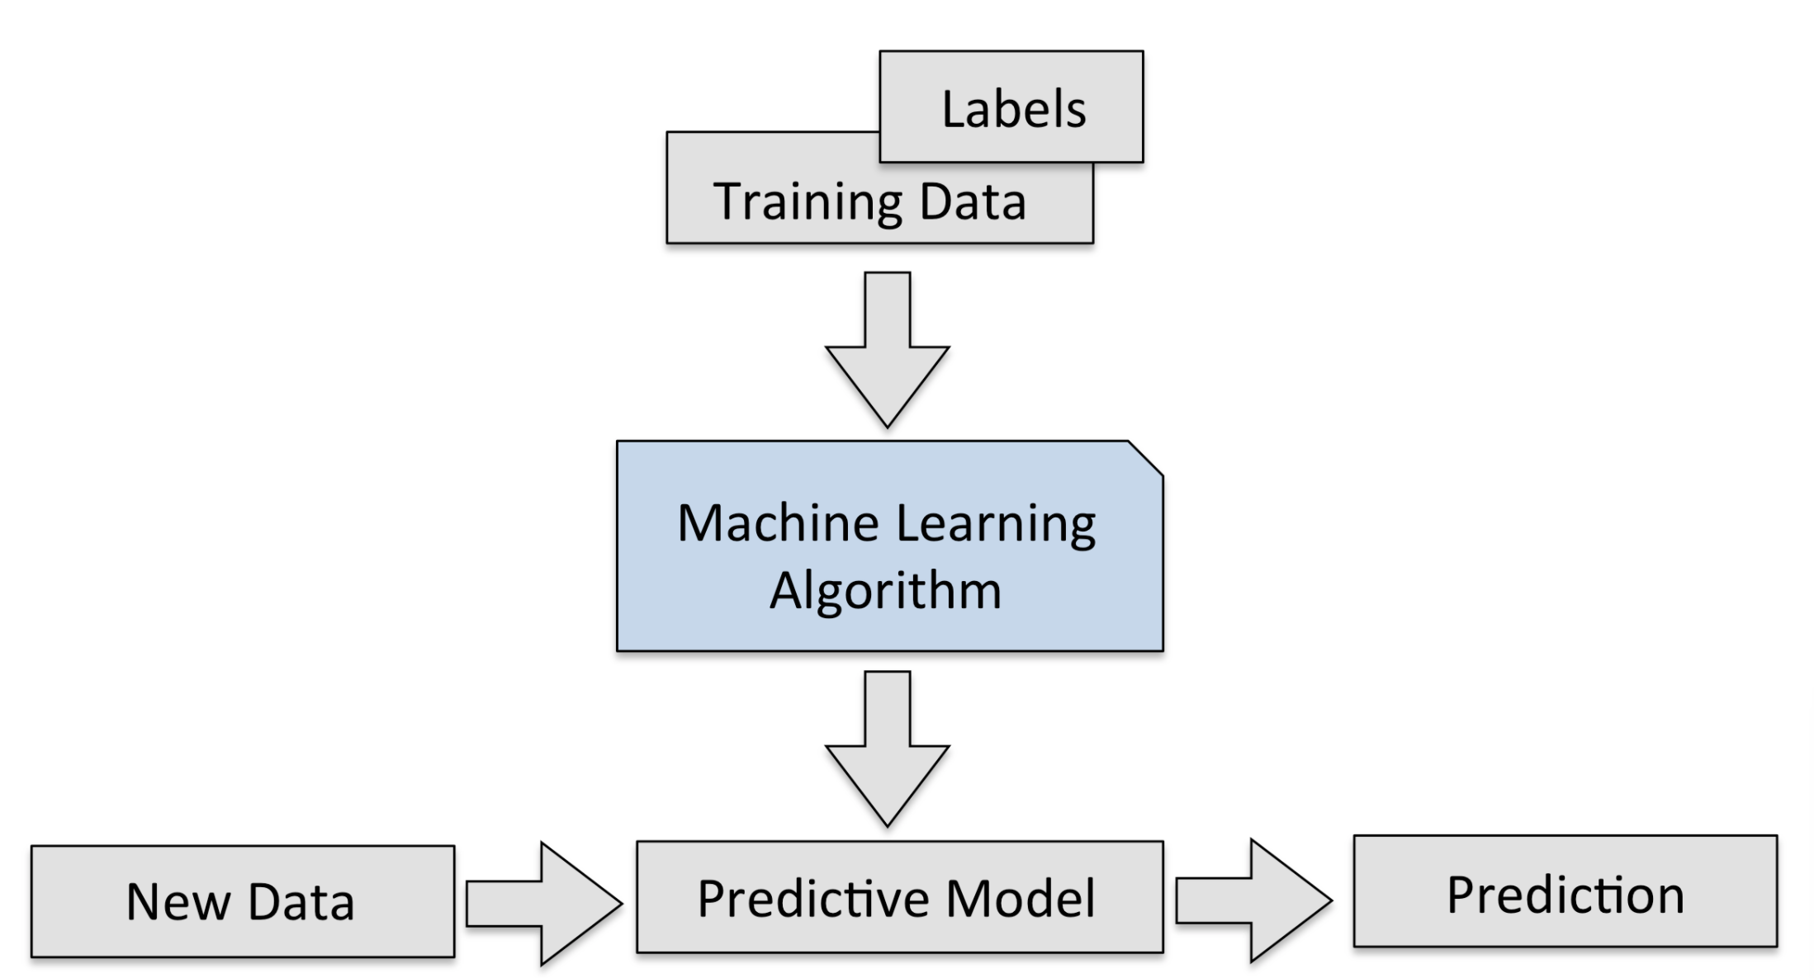
Linear Regression

Slide 34
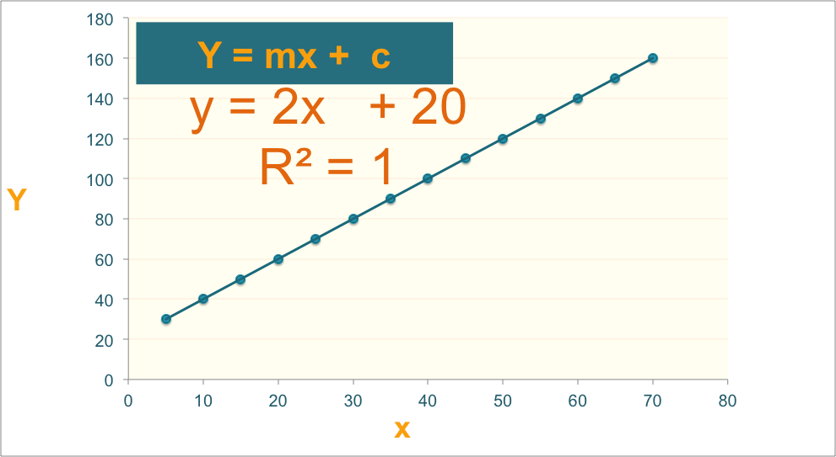
Linear Regression

Slide 35
Regression Algorithm
Ordinal Regression
Poisson Regression
Linear, polynomial, Lasso, Stepwise, Ridge Regression
Bayesian Network Regression
Neural Network Regression
Decision Forest Regression
Boosted Decision Tree Regression
K-nearest neighbors (KNN)

Slide 36
Data Preparation for modeling
Linear Assumption
Remove Noise
Feature Engineering
Remove Collinearity
Rescale Input

Slide 37
Model Evaluation
Regression Evaluation Metrics
Mean Squared Error (MSE),
Root Mean Square Error (RMSE) &
Mean Absolute Error (MAE)
R-squared (Coefficient of Determination)

Slide 38
Machine learning courses
https://www.kaggle.com/learn/overview
https://developers.google.com/machine-learning/crash-course
Andreww Ng’s Machine learning course
IBM Data Science Professional Certificate (PAID)
Machine Learning with TensorFlow on Google Cloud Platform Specialization
Machine Learning Data Science Course (Harvard University)
Fast.ai course

Slide 39
Upcoming Courses
Pandas for Data Analysis
SQL Basics for Data Science
Complete a project and add to your Github portfolio

Slide 40
Pandas for Data Analysis
Getting Started with pandas
Package Overview
Exploring panda
Essential Basic Functionality
Introduction to Data Structures
Comparison with Other Tools
User Guide

Slide 41
Upcoming Courses
Pandas for Data Analysis
Getting Started with pandas
Package Overview
Exploring panda
Essential Basic Functionality
Introduction to Data Structures
Comparison with Other Tools

Slide 42
Pandas for Data Analysis
User Guide
Indexing and Selecting Data
MultiIndex/Advanced Indexing
Merge, Join, and Concatenate
Reshaping and Pivot Tables
Working with Text Data, Missing Data, and Categorical Data
Nullable Integer Data Type
Visualisations
Computational Tools
Group By: Split-Apply-Combine
Time Series and Time Deltas
Stylings
Options and Settings
Enhancing Performance
Sparse Data Structures
pandas Ecosystem
Statistics and Machine Learning
Visualisation
IDE
Data Validation
Extension Data Types

Slide 43
Feature Engineering
Feature extraction

Slide 44

Flourishing Life
Home Courses Blog
Get Started
We help you launch your data science career
Learn More

Slide 45
Flourishing Life
Home Courses Blog
Get Started
Python Foundation
Data Analysis with Python Pandas
SQL Basics for Data Science
Machine learning Level-2
Deep Learning
Courses
Machine Learning
Level-1
Amazon Web service Machine Learning Foundation
Apache Spark for Machine Learning and Data Science
Fast Data Visualization with Python

Slide 46
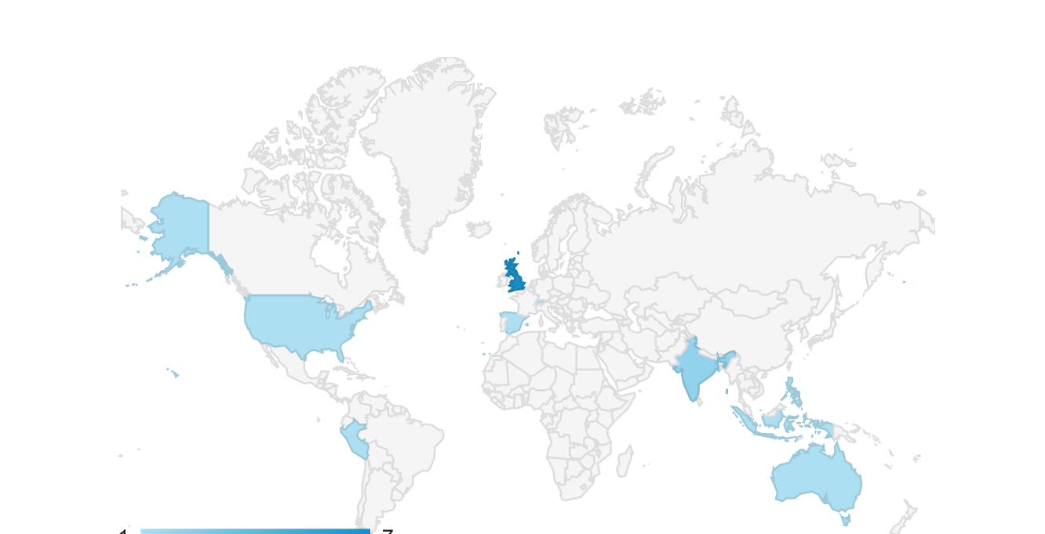
Courses
Flourishing Life
Home Courses Blog
Get Started
Where our students are from

Slide 47
Flourishing Life
Home Courses Blog
Get Started
Learn More
Get Started

Slide 48
Courses
Home Courses Blog
Get Started
Launch your career
Blog
Showcase
Try our neural network projects.
Check what you can build
Resources and Scholarships

Slide 49

Courses
Home Courses Blog
Get Started
Resources and Scholarships
Get Started

Slide 50
Courses
Home Courses Blog
Get Started
N=118 | Predicted No | Predicted Yes
True Negative (NO) | TN = 74 | FP = 6 | 80
True Positive (Yes) | FN = 27 | TP = 11 | 38
 | 101 | 17

Slide 51
Data preparation and visualization
Dr. Suraiya Zabeen

Slide 52
What is going to be covered
Data Cleaning
- Check if there is missing values in your data
- String Manipulation
Application of regular expression
Pandas groupby
Creating functions, lambda function, applying functions

Slide 53
Learning Outcome
Data visualization
Histogram
Choropleth map
Bar plot

Slide 54
EVENTS calendar

